Slide 1


Network Simulation Study
A Study on the Performance and Interference Mitigation of Wi-Fi 6 & 7 Technologies
NIS-S11- 7
Chung, Ford Ainstein
Cipriano, Johans Venedict
Valenzuela, Shanley

Slide 2

Goal of This Study
Compare Advancements in Wi-Fi 6 and Wi-Fi 7, Focusing on Improvements in Network Performance and Addressing Interference Issues in Wireless Ethernet Networks to Understand the Evolution and Future of Internet Connectivity.

Slide 3

Wi-Fi 6 (802.11ax)
Launched in 2019
Designed to address challenges in crowded environments

Slide 4
Wi-Fi 6 Comparison
IEE 802.11 Protocol | Release Date | Frequency Bands (GHz) | Bandwidth (MHz) | Modulation | Maximum Linkrate
Wi-Fi (802.11) | 1997 | 2.4 GHz | NA | NA | NA
Wi-Fi 1 (802.11b) | 1999 | 2.4 GHz | 22 | DSSS | 11 Mbps
Wi-Fi 2 (802.11a) | 1999 | 5 GHz | 20 | OFDM | 54 Mbps
Wi-Fi 3 (802.11g) | 2003 | 2.4 GHz | 20 | DSSS, OFDM | 54 Mbps
Wi-Fi 4 (802.11n) | 2008 | 2.4/5 GHz | 20/40 | 64-QAM OFDM | 1.2 Gbps
Wi-Fi 5 (802.11ac) | 2012 | 2.4/5 GHz | 20/40/80/160 | 256-QAM OFDM | 3.5 Gbps
Wi-Fi 6 (802.11ax) | 2019 | 2.4/5 GHz | 20/40/80/160 | 1024-QAM OFDM | 9.6 Gbps
Wi-Fi 6E (802.11ax) | 2021 | 2.4/5/6 GHz | 20/40/80/160 | 1024-QAM OFDM | 9.6 Gbps

Slide 5





Wi-Fi 6 Features
data
data
data
OFDMA
Orthogonal Frequency Device Multiple Access
Subdividing Channels into smaller Resource Units
Allowing multiple Devices to transmit Data simultaneously
Allows better use of the Channel

Slide 6



Wi-Fi 6 Features
OFDMA
Orthogonal Frequency Device Multiple Access
MU-MIMO
Multi-User, Multiple input, Multiple output
Uses Spatial Multiplexing on the same Bandwidth
Supports 8 Devices for simultaneous Connections
Supports Uplink & Downlink MU-MIMO

Slide 7
Wi-Fi 6 Features
BSS Coloring
Adds a Color Code to each Basic Service Set
Helps Devices distinguish between Signals
Reduces Interference

Slide 8
Wi-Fi 7 (802.11 be)
Wi-Fi 7 was created to accommodate the needs of new technology such as 4k/8k streaming and VR/AR which requires extremely high throughput
It contains massive improvements to both the MAC and PHY layers to achieve the speed required for Wi-Fi 7

Slide 9
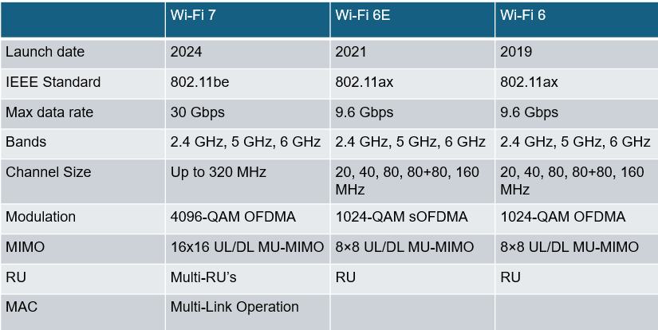
Wi-Fi 7 Comparison

Slide 10
Wi-Fi 7 MAC
Multi-Link Operation
A feature giving ability to transmit data across different frequency bands simultaneously.
84.5% improvement compared to a single-link operation
Multiple-input and Multiple-Output(MIMO)
Utilizes 16 antennas allowing 16 independent data streams simultaneously, utilizing multiple antennas for both transmitting and receiving data

Slide 11
Wi-Fi 7 MAC
Multi-AP coordination
Allow sharing of data and control information among access point devices using physical or wireless links, increasing overall efficiency
HARQ
A method to increase transmission reliability by strong incorrect decoded information and adding it to the retransmitted data

Slide 12
Wi-Fi 7 PHY
Enhanced Channeling
It utilizes 320 MHz channel that can be continuous in the same band or noncontinuous on different bands
4096-QAM
The number of distinct signal combinations that can be used to represent data
Increase of at most 20% in data rate

Slide 13
Interference Mitigation
Physical Layer (PHY)
1.Orthogonal Frequency Division Multiplexing (OFDM)
2.Channel Allocation and Power Control
3.Error Correction
4.Beamforming
Medium Access Control Layer (MAC)
1.Carrier Sense Multiple Access with Collision Avoidance (CSMA/CA)
2.Request to Send / Clear to Send (RTS/CTS)
3.BSS Coloring
4.Spatial Reuse
5.Time-Sensitive Networking

Slide 14



Methodology
ChatGPT provides information similar to the ones discussed in the paper however it lacks an in-depth explanation for it
The discussion with ChatGPT in the context of Wi-Fi 7 and Wi-Fi 6 did provide adequate and additional information, however, it also did not cover some of the most important features of Wi-Fi 7 such as MIMO and HARQ
ChatGPT provided a Comparison Table of Wi-Fi Technologies. Yet it only listed the Max Speed for normal conditions, without noting that ideal conditions could result higher performance.

Slide 15
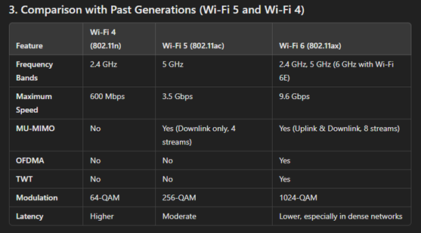
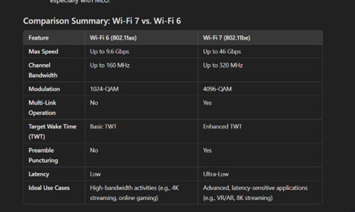
Methodology

Slide 16
Conclusion
Wi-Fi 6 introduced key features such as OFDMA, MU-MIMO, and BSS
Wi-Fi 7 built upon these innovations by adding greater channel bandwidth, advanced modulation techniques, and technologies like MLO and Multi-AP Coordination.
At the PHY layer, Wi-Fi 6 introduced 1024-QAM modulation, allowing a 25% increase in data rates compared to Wi-Fi 5's 256-QAM. Wi-Fi 7 takes this further with 4096-QAM, improving data rates by an additional 20%. Wi-Fi 6 expanded channel bandwidth to 160 MHz, while Wi-Fi 7 doubles this to 320 MHz, enabling significantly faster data transmission.
At the MAC layer, Wi-Fi 6 expanded MU-MIMO capabilities. Wi-Fi 7 doubles this capacity to 16 users and introduces enhanced features like Hybrid Automatic Repeat Request (HARQ).
BSS Coloring, introduced in Wi-Fi 6, remains in Wi-Fi 7. Multi-AP Coordination in Wi-Fi 7 further optimizes channel use and improves overall network performance in areas with multiple access points.
Interference mitigation strategies include OFDM, Channel Allocation and Power Control, FEC, and Beamforming in PHY and CSMA/CA, RTS/CTS, BSS Coloring, Spatial Reuse, and TSN in MAC.

Slide 17
Thank You
For Your Attention

Slide 18
References:
Μ. (. M. &. M. B. Μπαλκώνης, "Wi-Fi Evolution: Beyond Wi-Fi 6," ProQuest Dissertations & Theses, Piraeus, 2021.
C. F. X. H. X. W. X. Y. L. H. R. L. Y. G. Y. Deng, "IEEE 802.11be Wi-Fi 7: New Challenges and Opportunities," IEEE Communications surveys and tutorials, 2020-01, vol. Vol.22 (4), pp. p.2136-2166, 2020.
A. Jeknić and E. Kočan, "Multi-Link Operation for Performance Improvement in Wi-Fi 7 Networks," in 2024 28th International Conference on Information Technology (IT), 2024.
M. Alabi, "The Evolution of Wi-Fi Standards: From Wi-Fi 6 to Wi- Fi 7," 2023.
K. Abdullah, "Interference mitigation techniques for wireless OFDM," School of Engineering, RMIT University. Thesis, 30 October 2024.
H. Arra ̃no and C. Azurdia-Meza, "OFDM: Today and in the Future of Next Generation Wireless Communications," 35th IEEE Convencion de Estudiantes de Centroamerica (CONESCAPAN 2016), September 2016.
A. Rahman, W. Hoh, S. Zakaria and N. Bakar, "IoT Wireless Protocol with 802.11AH: A Study of Interference Mitigation Techniques," Proceedings of the 2nd International Conference on Emerging Technologies and Intelligent Systems, 9 February 2023.
N. Su and Q. Zhu, "Power Control and Channel Allocation Algorithm for Energy Harvesting D2D Communications," Algorithms, vol. 12, no. 5, 2019.
E. Tokhirov, R. Aliev, I. Tanaino and T. Dzholdosheva, "Analysis of the differences between Wi-Fi 6 and Wi-Fi 5," E3S Web of Conferences, vol. 402, no. No issue number, pp. 3020-, 2023.
E. Khorov, I. Levitsky and I. F. Akyildiz, "Current Status and Directions of IEEE 802.11be, the Future Wi-Fi 7," IEEE Communications Surveys & Tutorials, vol. Volume: 22, no. 4, pp. 2136 - 2166, 2020.
t. Oyedare, V. Shah, D. Jakubisin and J. Reed, "Interference Suppression Using Deep Learning: Current Approaches and Open Challenges," IEEE Access, 21 June 2022.
J. K. N. a. P. N. T. Pulkkinen, "Understanding WiFi Cross-Technology Interference Detection in the Real World," 2020 IEEE 40th International Conference on Distributed Computing Systems (ICDCS), 23 February 2021.

